Slide 1


Software Design & Analysis

Slide 2
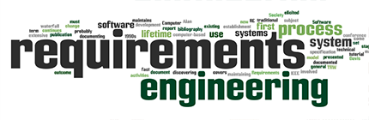

Slide 3
Lecture Material
Ian Sommerville (Chapter 4)
Roger S. Pressman (Chapter 8)
System Analysis and Design by Alan Dennis (Chapter 3)

Slide 4
Lecture Objectives
Requirements Fundamentals
Types of Requirements
Level of Details
Nature of Requirements
Requirements Engineering Process
Requirements Issues
Requirements Analysis

Slide 5
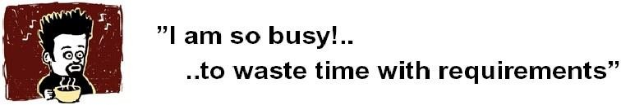
The Root Causes of Project Success and Failure
The first step in resolving any problem is to understand the root causes.
The 1994 Standish Group survey study noted the three commonly cited factors that caused projects to be
Lack of user input: 13 percent of all projects
Incomplete requirements and specifications: 12 percent of all projects
Changing requirements and specifications: 12 percent of all projects

Slide 6
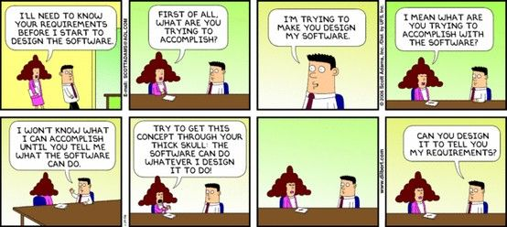

Slide 7
Requirement
Requirements form the basis for all software products
The process of finding out, analyzing, documenting and checking the services and constraints is called requirements engineering (RE).
Requirements engineering is the process, which enables us to systematically determine the requirements for a software product
Something required, something wanted or needed
Webster’s dictionary
There is a huge difference between wanted and needed and it should be kept in mind all the time
Need- something you have to have
Want -something you would like to have

Slide 8
Requirements
Requirements are ... A specification of what should be implemented. They are descriptions of how the system should behave, or of a system property or attribute. They may be a constraint on the development process of the system.
A condition or capability that must be met or possessed by a system...to satisfy a contract, standard, specification, or other formally imposed document
IEEE Std 729
Can be constraint
Functionality

Slide 9
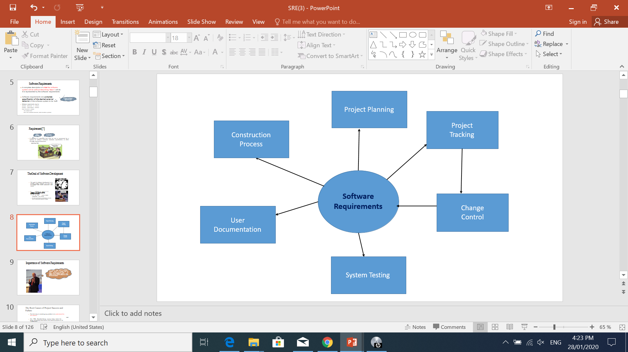
Role of Requirements

Slide 10
Why Are Requirements Important?
Clear Goals – Helps developers understand what needs to be built.
Avoid Miscommunication – Ensures all stakeholders (clients, developers, testers) are aligned.
Quality Assurance – Helps in verifying and validating the system.
Legal & Standard Compliance – Ensures the system follows regulations.

Slide 11
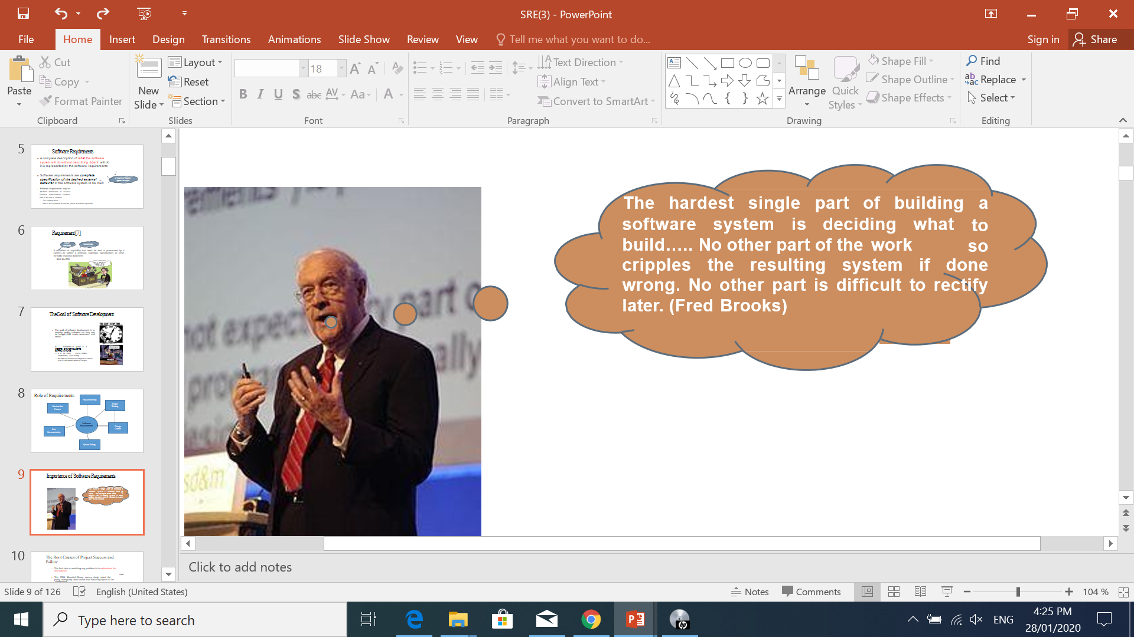
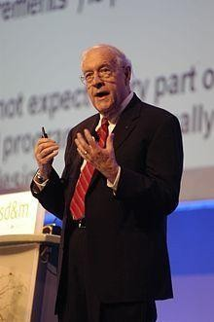

Importance of Software Requirements

Slide 12
Importance of Software Requirements
Fredrick Brooks :
“The hardest part of building a software system is deciding precisely what to build.
No other part of the conceptual work is as difficult as establishing the detailed technical requirements, including all of the interfaces to people, to machines, and to other software systems.
No other part of the work so cripples the resulting system if done wrong.
No other part is more difficult to rectify later”
Karl Wiegers
“If you don’t get the requirements right, it doesn’t matter how well you do anything else.”
One can end up doing a perfect job of building the wrong product.

Slide 13
A patient information system for mental health care
A patient information system to support mental health care (the Mentcare system) is a medical information system that maintains information about patients suffering from mental health problems and the treatments that they have received.
To make it easier for patients to attend, these clinics are not just run in hospitals. They may also be held in local medical practices or community centers.

Slide 14
A patient information system for mental health care
This system has two purposes:
To generate management information that allows health service managers to assess performance against local and government targets.
To provide medical staff with timely information to support the treatment of patients.

Slide 15
Key Features
The key features of the system are:
1. Individual care management Clinicians can create records for patients, edit the information in the system, view patient history, and so on. The system supports data summaries so that doctors who have not previously met a patient can quickly learn about the key problems and treatments that have been prescribed.
2. Patient monitoring The system regularly monitors the records of patients that are involved in treatment and issues warnings if possible problems are detected. Therefore, if a patient has not seen a doctor for some time, a warning may be issued. One of the most important elements of the monitoring system is to keep track of patients who have been sectioned and to ensure that the legally required checks are carried out at the right time.

Slide 16
Key Features
Administrative reporting The system generates monthly management reports showing the number of patients treated at each clinic, the number of patients who have entered and left the care system, the number of patients sectioned, the drugs prescribed and their costs, etc.

Slide 17
Requirements Classification
User Requirements
System Requirements

Slide 18
Requirements Types
User requirements are statements, in a natural language plus diagrams (conceptual models), of what services the system is expected to provide to system users and the constraints under which it must operate. The user requirements may vary from broad statements of the system features required to detailed, precise descriptions of the system functionality.
System requirements are more detailed descriptions of the software system’s functions, services, and operational constraints. The system requirements document (sometimes called a functional specification) should define exactly what is to be implemented. It may be part of the contract between the system buyer and the software developers.

Slide 19
Requirements Types
Example (Online Banking System - User Requirement):
"The system shall allow users to transfer money between their accounts."
"Users should be able to log in securely using a username and password."
"The system should send an email notification for each successful transaction."
Example (Online Banking System - System Requirement):
"The system shall authenticate users using a SHA-256 hashed password stored in the database."
"Funds transfer requests shall be processed within 5 seconds and use HTTPS encryption."
"The system shall generate an email notification within 2 seconds of a completed transaction and log it in the audit database."

Slide 20
Requirements Types
E-commerce Website: User Requirement:
"The system shall allow customers to search for products by name, category, and price."
"Users should be able to add items to a shopping cart and proceed to checkout."
"The website should provide multiple payment options, including credit card and PayPal."
System Requirement:
"The system shall implement a search functionality using a full-text search algorithm on the product database, indexed for fast retrieval."
"The shopping cart shall store selected items in a session variable and persist them for at least 30 minutes of inactivity."
"The payment processing module shall integrate with Stripe and PayPal APIs, using TLS 1.2 encryption for transactions."

Slide 21
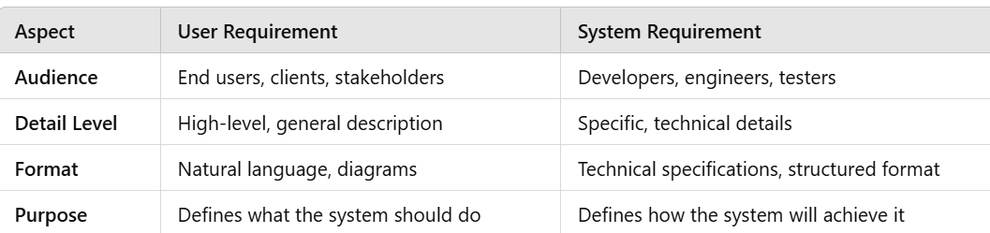
Requirements Types

Slide 22
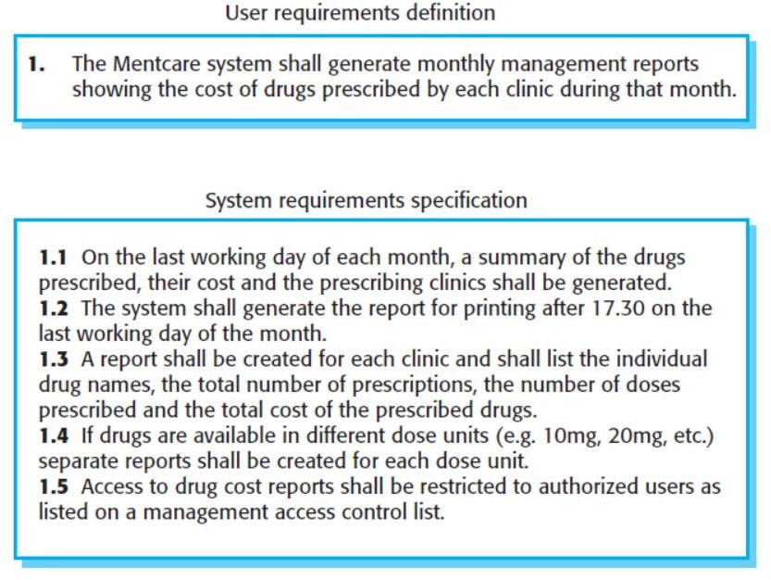
Mental health care patient information system (Mentcare)

Slide 23
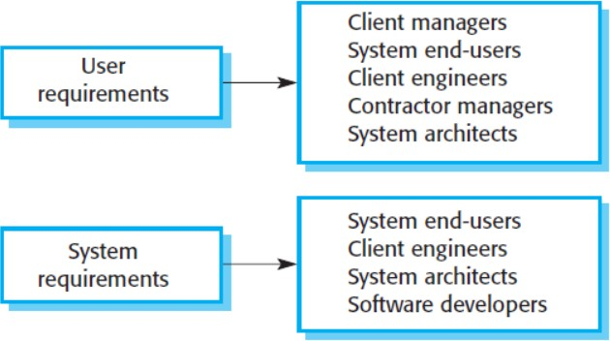
Requirements
You need to write requirements at different levels of detail because different types of readers use them in different ways.
The readers of the user requirements are not usually concerned with how the system will be implemented and may be managers who are not interested in the detailed facilities of the system.
The readers of the system requirements need to know more precisely what the system will do because they are concerned with how it will support the business processes or because they are involved in the system implementation.
In figure there are examples of system stakeholders. Many stakeholders like end-user, manager,

Slide 24
System stakeholders for the Mentcare system
Mental health care patient information system (Mentcare)
Patients whose information is recorded in the system and relatives of these patients.
Doctors who are responsible for assessing and treating patients.
Nurses who coordinate the consultations with doctors and administer some treatments.
Medical receptionists who manage patients’ appointments.
IT staff who are responsible for installing and maintaining the system.
A medical ethics manager who must ensure that the system meets current ethical guidelines for patient care.
Health care managers who obtain management information from the system.
Medical records staff who are responsible for ensuring that system information can be maintained and preserved, and that record keeping procedures have been properly implemented.
Notes:
Stakeholder refers to, “a person, group or company that is directly or indirectly involved in the project and who may affect or get affected by the outcome of the project”.

Slide 25
Activity
Question 1. Identify possible stakeholders in the following systems:
(1) A stockholding system for oil companies which keeps track of the amount of petrol (gas) at each of its sales outlets and automatically reorders new stock
(2) A train protection system which will automatically bring a train to a halt if it exceeds the speed limit for a track segment or if it goes through a red signal. when the tanks fall below a certain level.

Slide 26
Activity
(1) A stockholding system for oil companies which keeps track of the amount of petrol (gas) at each of its sales outlets and automatically reorders new stock when the tanks fall below a certain level.
Response: Possible stakeholders are fuel delivery drivers, service station owners, service station sales staff, fuel supply operators, oil company management, oil company accountants, oil company buyers
(2) A train protection system which will automatically bring a train to a halt if it exceeds the speed limit for a track segment or if it goes through a red signal.
Response: Possible stakeholders train passengers, train driver, signallers, train operating company management, railway safety authorities, training staff

Slide 27
Levels of Requirements
Business Requirements
User Requirements
Functional Requirements
Non-Functional Requirements

Slide 28
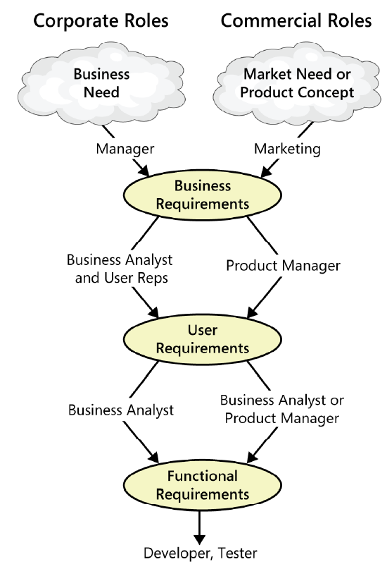
Requirements Types – Level of Details

Slide 29
Business Requirements
WHY the Software Product is being developed”- Stated as “OBJECTIVES”.
These are used to state the high-level business objective of the organization or customer requesting the system or product
They are used to document main system features and functionalities without going into their nitty-gritty details
They are captured in a document describing the project vision and scope
A business requirement defines what an organization needs to achieve a specific goal, solve a problem, or improve a process. It outlines the high-level needs of a business without focusing on technical details.

Slide 30
Business Requirements
For example, a web application is designed and developed to offer better parcel delivery services to customers.
What is the business requirement ?
Offer a smarter solution to measure, select, and ship parcels
Provide capabilities to track and manage their delivery and pick-up services
On-time delivery and customer feedback

Slide 31
Key Aspects of Business Requirements:
Objective: The purpose or goal of the requirement (e.g., improving customer service, increasing sales).
Stakeholders: The people or departments affected by the requirement (e.g., customers, employees, management).
Scope: Defines the boundaries of the requirement—what is included and what is not.
Functional Needs: High-level business functions that the solution must support.
Constraints: Limitations like budget, time, or regulatory requirements.
Success Criteria: Measurable outcomes that determine if the requirement is met.

Slide 32
Key Aspects of Business Requirements:
E-commerce Website
Improvement Objective: Increase online sales by 20% in 6 months.
Stakeholders: Marketing team, IT team, customers.
Scope: Improve APP UI, add a recommendation system, and streamline checkout.
Constraints: Budget of $50,000, implementation within 3 months.
Success Criteria: Higher conversion rates, improved user engagement, and increased sales.

Slide 33
Key Aspects of Business Requirements:
Objectives
The mobile app will offer a user-friendly and seamless shopping experience, enabling customers to browse products, add them to their cart, and complete purchases with ease.
The app will incorporate features like special deals, targeted promotions, and an easy checkout process to drive higher conversion rates and increase overall sales.
Through push notifications and personalized offers, the app will keep customers engaged and informed, thereby increasing brand loyalty and repeat business.

Slide 34
User Requirements
User requirements add further detail to the requirements
User requirements are statements of what services the system is expected to provide to system users and the constraints under which it must operate.

Slide 35
Functional Requirements
These are statements of services the system should provide, how the system should react to particular inputs, and how the system should behave in particular situations
Depend on the type of software being developed
When expressed as user requirements, functional requirements should be written in natural language so that system users and managers can understand them.
Functional system requirements expand the user requirements and are written for system developers. They should describe the system functions, their inputs and outputs, and exceptions in detail.
In some cases, the functional requirements may also explicitly state what the system should not do

Slide 36
Mentcare (Example)
A user shall be able to search the appointments lists for all clinics.
The system shall generate each day, for each clinic, a list of patients who are expected to attend appointments that day.
Each staff member using the system shall be uniquely identified by his or her eight-digit employee number.

Slide 37
Non-Functional Requirements
These are constraints on the services or functions offered by the system
They include timing constraints, constraints on the development process, and constraints imposed by standards
Non-functional requirements often apply to the system as a whole, rather than individual system features or services
For example, to ensure that performance requirements are met in an embedded system, you may have to organize the system to minimize communications between components.

Slide 38
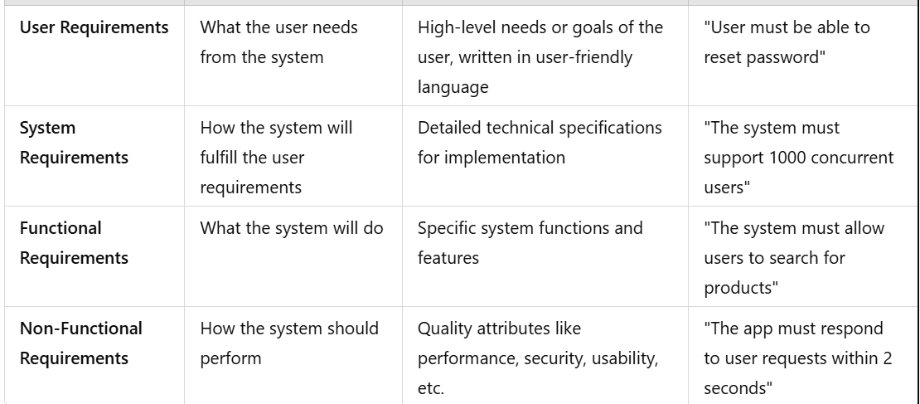

Slide 39
Non-Functional Requirements
Non-Functional
requirements
Product requirements
Organizational requirements
External requirements

Slide 40
Non-Functional Requirements
Product requirements
These requirements specify or constrain the behavior of the software.
Examples include performance requirements on how fast the system must execute and how much memory it requires, reliability requirements that set out the acceptable failure rate, security requirements, and usability requirements.
Organizational requirements
These requirements are broad system requirements derived from policies and procedures in the customer’s and developer’s organization.
Examples include operational process requirements that define
how the system will be used,
development process requirements that specify the programming language, the development environment or process standards to be used, and
environmental requirements that specify the operating environment of the system.

Slide 41
Non-Functional Requirements
External requirements
This broad heading covers all requirements that are derived from factors external to the system and its development process.
These may include regulatory requirements that set out what must be done for the system to be approved for use by a regulator,
Central bank;
Legislative requirements that must be followed to ensure that the system operates within the law; and
Ethical requirements that ensure that the system will be acceptable to its users and the general public.

Slide 42
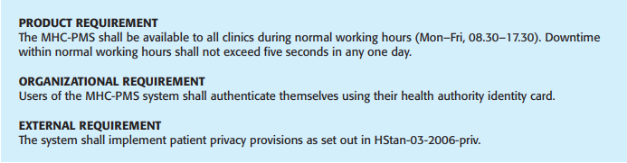
Non-Functional Requirements

Slide 43
Product Requirements
Efficient in speed of execution
After completion how much
time require to understand fully.
User supportive.
Available 24 hours.
No crash single time
Product
requirements
Usability requirements
Efficiency requirements
Reliability requirements
Portability requirements
Run on multiple platform(ma os, window, …)
Performance
requirements
Space
requirements
Notes:
PRODUCT REQUIREMENT The MHC-PMS shall be available to all clinics during normal working hours (Mon–Fri, 08.30–17.30). Downtime within normal working hours shall not exceed five seconds in any one day.

Slide 44
Product Requirements
Reliability and performance
The system shall allow one hundred thousand hits per minute on the website
The system shall not have down time of more than one second for continuous execution of one thousand hours
Mean time to failure

Slide 45
Organizational Requirements
Organizational
requirements
Standards requirements
Implementation requirements
Delivery requirements
Notes:
ORGANIZATIONAL REQUIREMENT Users of the MHC-PMS system shall authenticate themselves using their health authority identity card.

Slide 46
External Requirements
Relationship with other organizations.
External requirements
Interoperability requirements
Ethical requirements
Legislative requirements
Privacy
requirements
Safety
requirements
Notes:
EXTERNAL REQUIREMENT The system shall implement patient privacy provisions as set out in HStan-03-2006-priv

Slide 47
External Requirements
Multiple organization are going to use your same product.
Therefore software companies does not give code and documentation
External requirements
Interoperability requirements
Ethical requirements
Legislative requirements
Privacy
requirements
Safety
requirements

Slide 48
External Requirements
External requirements
Should handle by developer
Critical issues
Maintainability issues
Recovery Issues
Interoperability requirements
Ethical requirements
Legislative requirements
Privacy
requirements
Safety
requirements

Slide 49
External Requirements
The system shall not disclose any personal information about members of the library system to other members except system administrators
The system shall comply with the local and national laws regarding the use of software tools

Slide 50
Quality Factors
Portability
Reusability
Interoperability
Survivability
Safety
Manageability
Supportability
Replaceability
Functionality
Correctness
Reliability
Efficiency
Usability
Integrity
Maintainability
Flexibility
Testability
Security

Slide 51
Some Risks From Inadequate Requirement Process
Insufficient user involvement leads to unacceptable products
Creeping user requirements contribute to overruns and degrade product quality
Ambiguous requirements lead to ill-spent time and rework
Gold-plating by developers and users adds unnecessary features

Slide 52
Some Risks From Inadequate Requirement Process
Minimal specifications lead to missing key requirements
Overlooking the needs of certain stake holders leads to dissatisfied customers
Incompletely defined requirements make accurate project planning and tracking impossible

Slide 53
RE Process

Slide 54
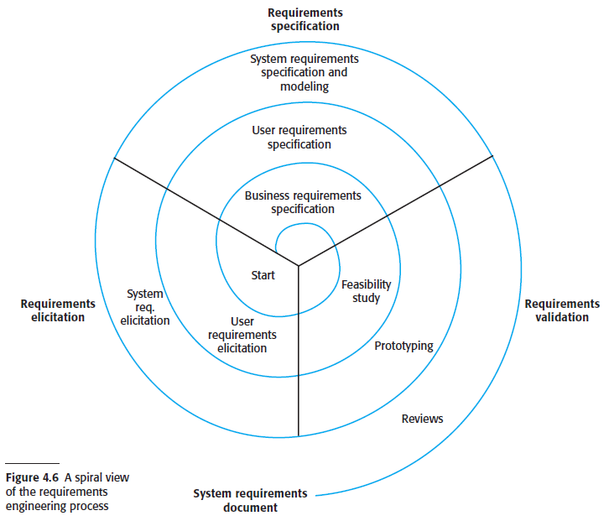
RE Process

Slide 55
RE Process
Involves technical staff working with customers to find out about the application domain, the services that the system should provide and the system’s operational constraints.
May involve end-users, managers, engineers involved in maintenance, domain experts, trade unions, etc. These are called stakeholders.

Slide 56
RE Process – Challenges
Stakeholders don’t know what they really want.
Stakeholders express requirements in their own terms.
Different stakeholders may have conflicting requirements.
Organisational and political factors may influence the system requirements.
The requirements change during the analysis process. New stakeholders may emerge and the business environment may change.

Slide 57
Ambiguous Requirements
The system should be easy to use by medical staff and should be organized in such a way that user errors are minimized.
Allows user to cancel sales orders.
The system provides searching of data quickly.
“The system is user friendly.”

Slide 58
Ambiguous Requirements
“Software produces a print normally in ten seconds.”
The staff shall be able to use all the system functionalities. The average number of errors made by users shall not exceed two per hour of system use.

Slide 59
Requirements imprecision
Problems arise when requirements are not precisely stated.
Ambiguous requirements may be interpreted in different ways by developers and users.
The system shall be secure.
What does the adjective "secure" mean?
Which properties shall the system provide in order to be "secure"?
How can one check whether the implemented system is "secure"?
Consider the term ‘search’ in requirement 1
User intention – search for a patient name across all appointments in all clinics;
Developer interpretation – search for a patient name in an individual clinic. User chooses clinic then search.

Slide 60
Requirements imprecision
In principle, requirements should be both complete and consistent.
Complete
They should include descriptions of all facilities required.
Consistent
There should be no conflicts or contradictions in the descriptions of the system features.
In practice, it is impossible to produce a complete and consistent requirements document.

Slide 61

Task - 1
Write down five functional requirements and five non-functional requirements of a mobile telephone.

Slide 62

Task - 2
Write down five functional requirements and five non-functional requirements of an online examination system.

